Slide 1

STAUNTON PARKS & RECREATION
SUMMER 2024

Slide 2
Parks & Recreation Highlights
Summer 2024
Community Brochure
Current Park Projects
Forthcoming Park Improvements
Golf Course Update
Summary & Questions

Slide 3

Brochure Highlights
Distributed to over 12,500 households in the City
Full Color Magazine Style Published Three Times a Year
Contains Vital Information for all programs, special events, trips, community happenings, child care, facility rentals, and department contacts in the coming months

Slide 4
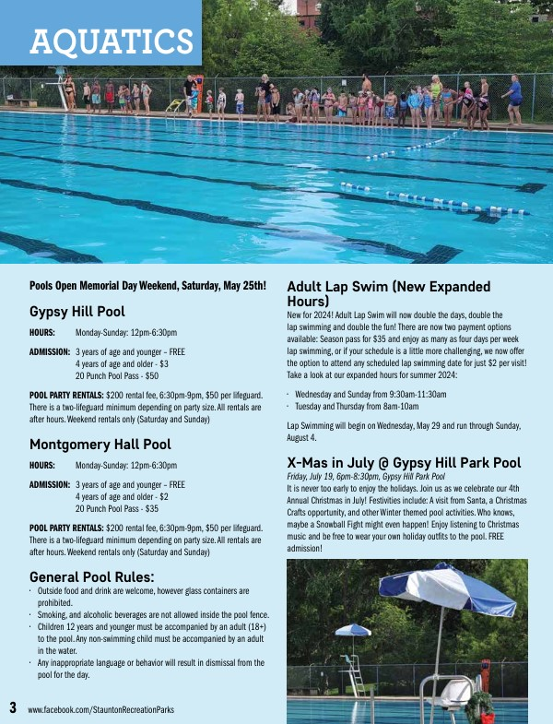
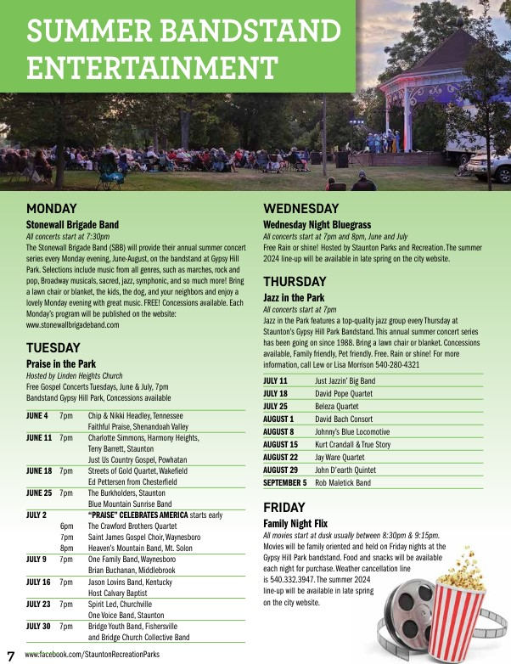
Brochure Examples
Important Pool Information
Exciting Bandstand Entertainment

Slide 5
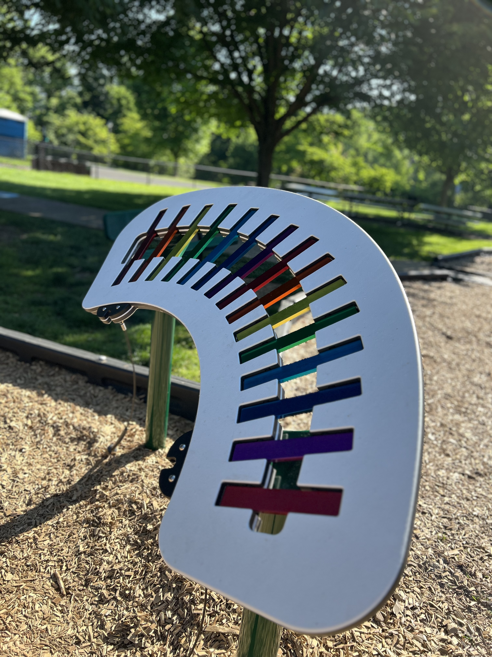
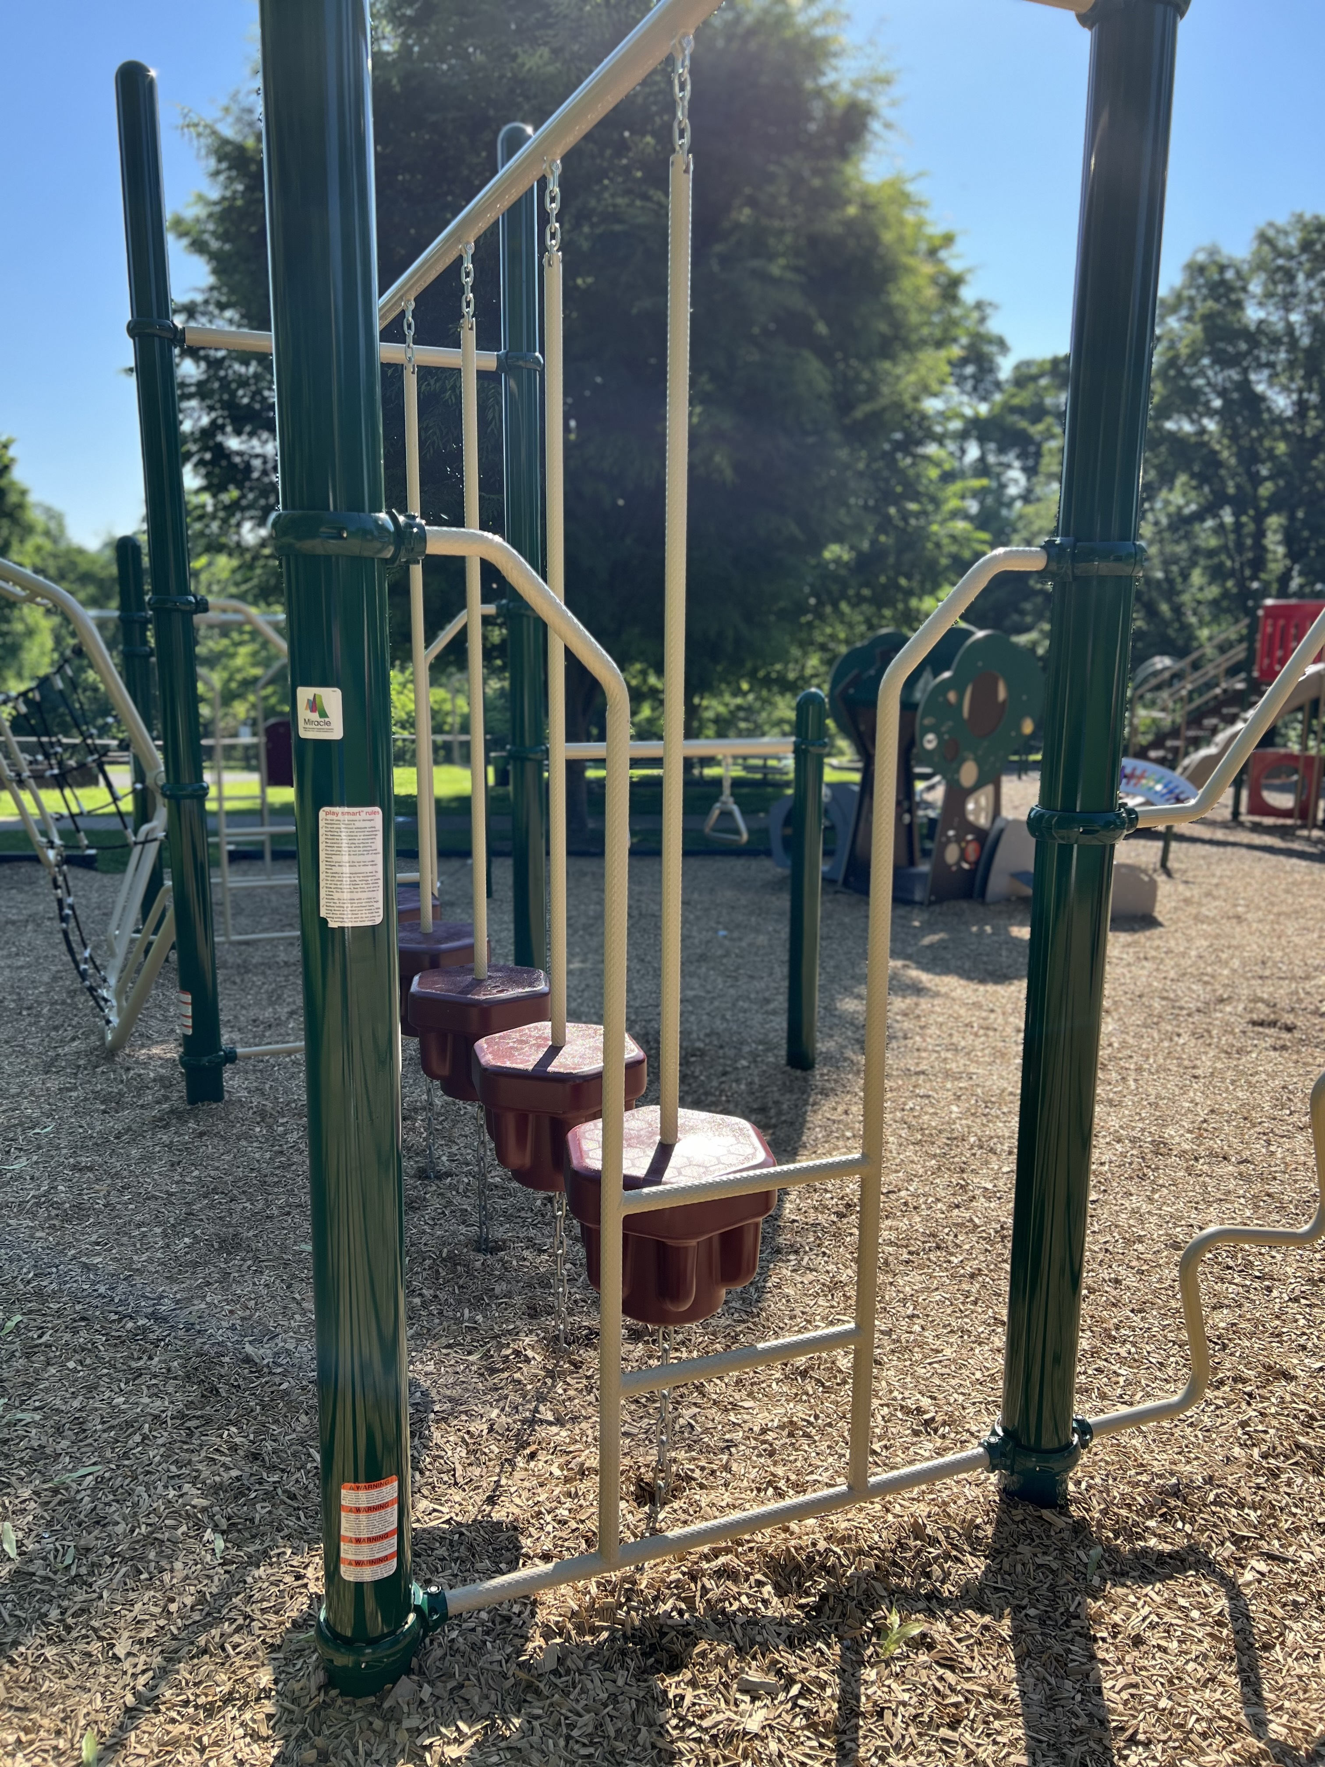
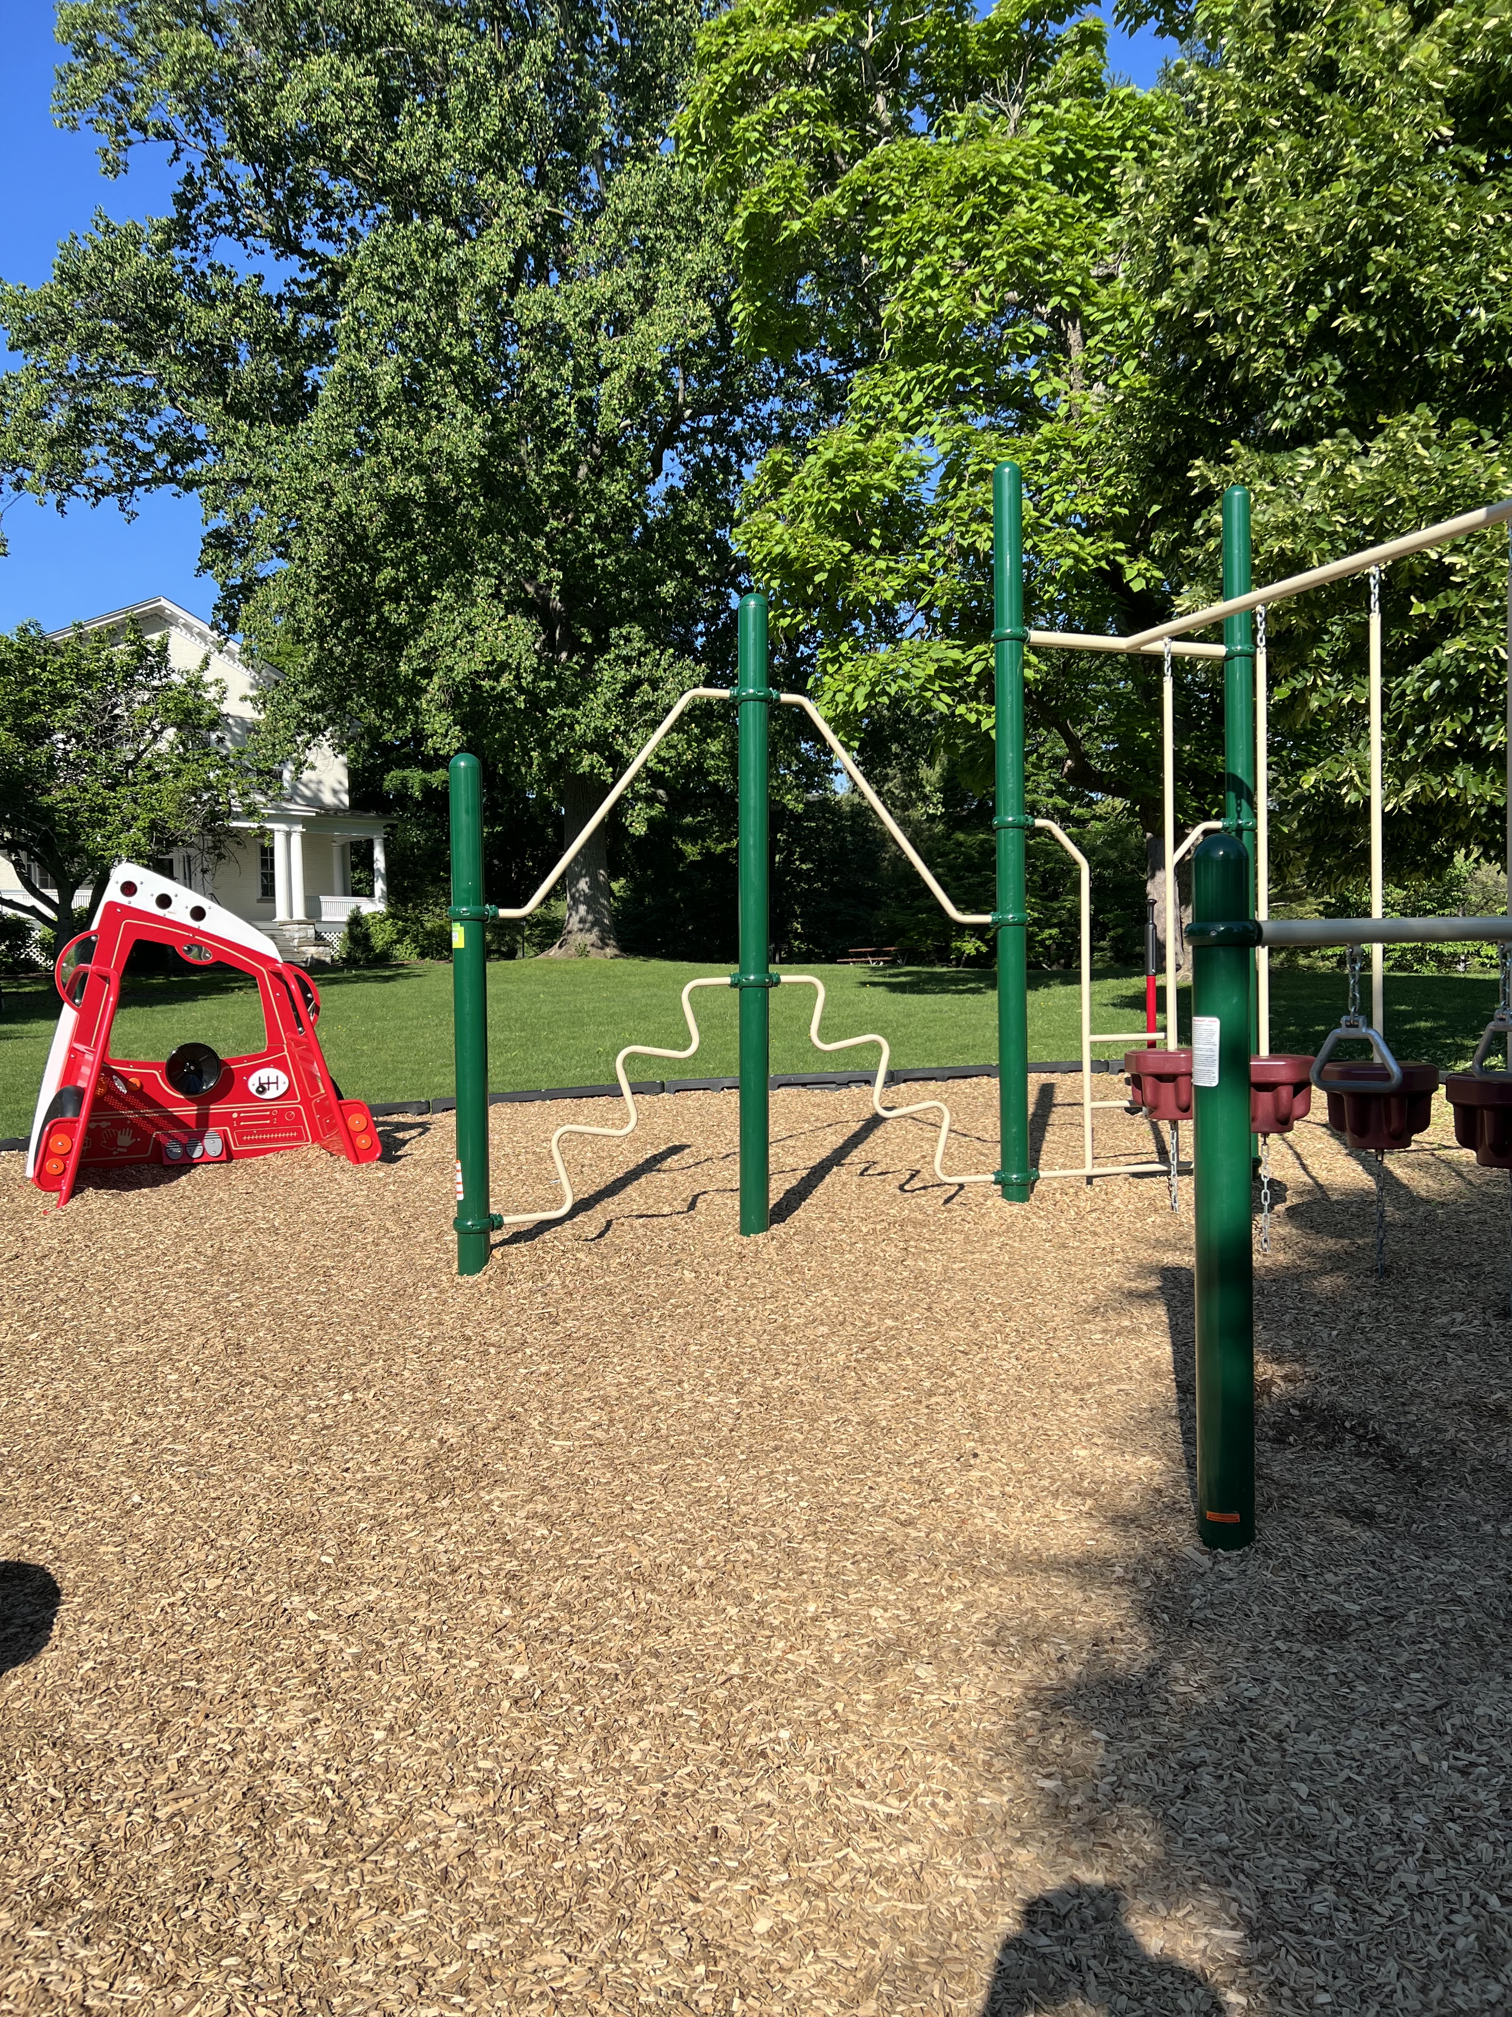
What’s New In The Parks
A New Playground Addition in Montgomery Hall Park

Slide 6
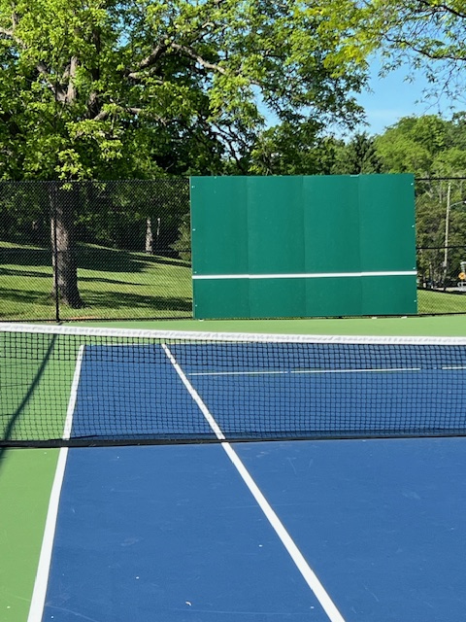
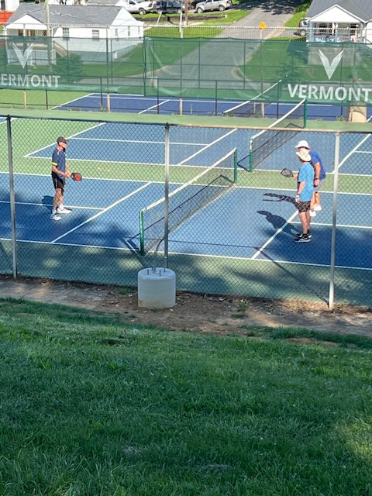
What’s New In The Parks
Tennis Court Revitalization in Montgomery Hall Park In Partnership with Staunton City Schools

Slide 7
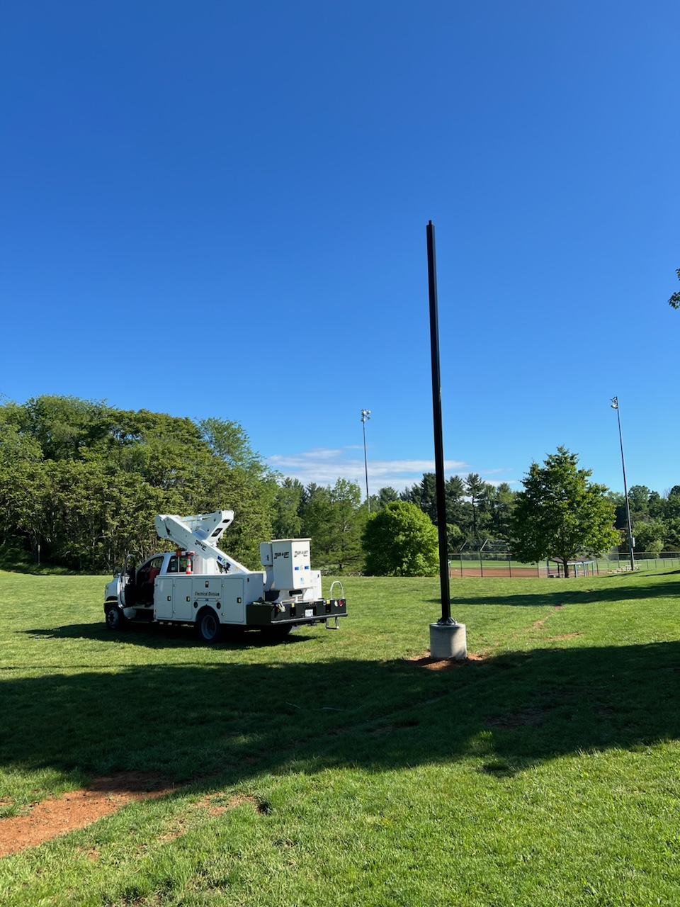
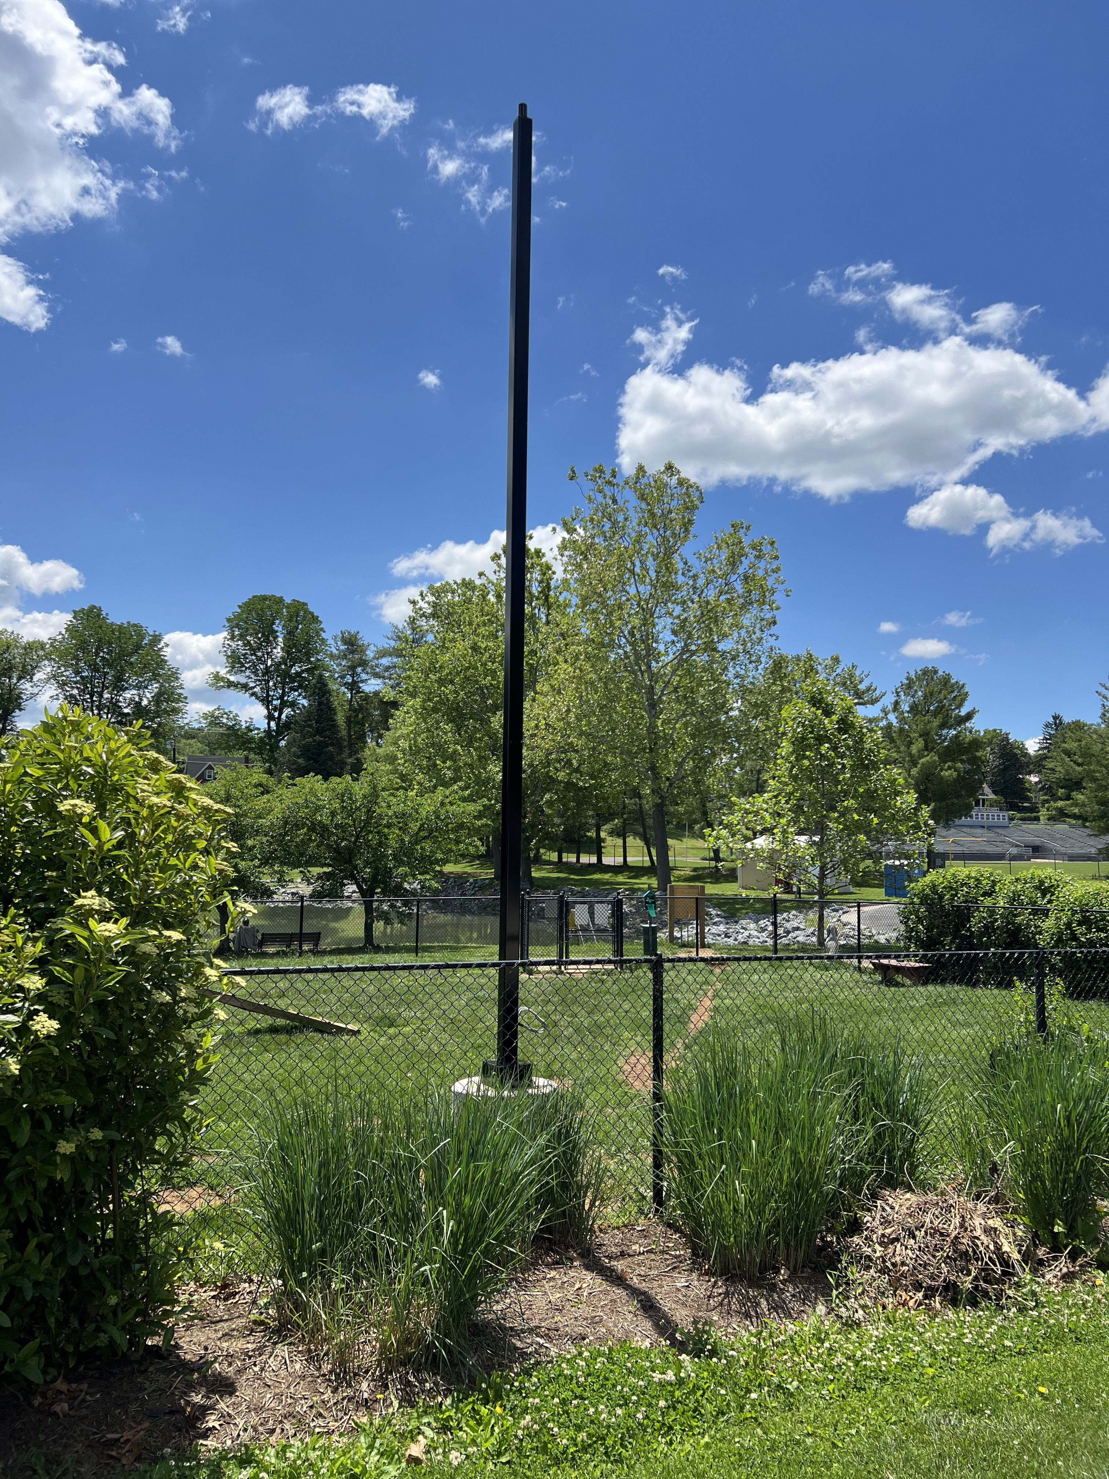
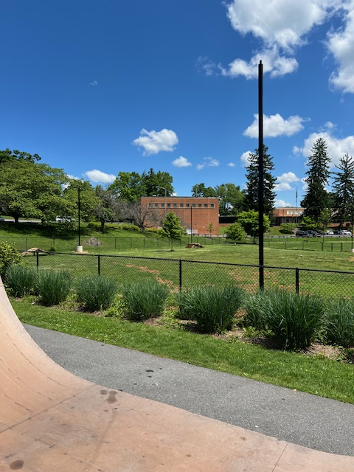
What’s New In The Parks
New Lighting Servicing Pickleball Courts, Tennis Courts, and Youth Sports Field in Montgomery Hall Park and New Lighting for The Bark Park and Skate Park in Gypsy Hill Park

Slide 8
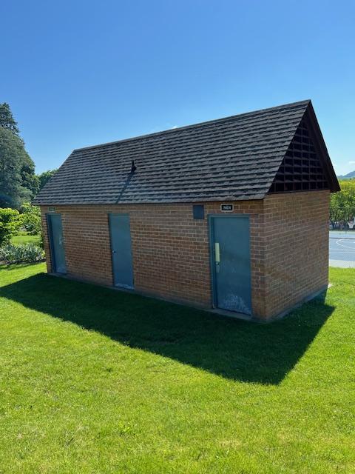
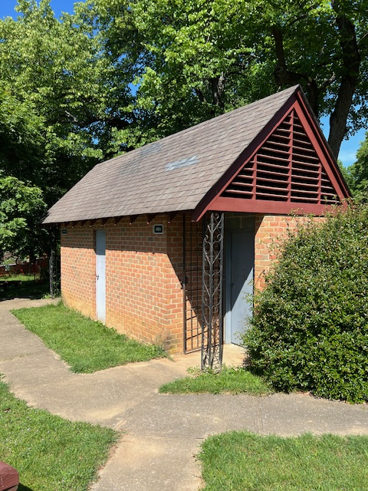
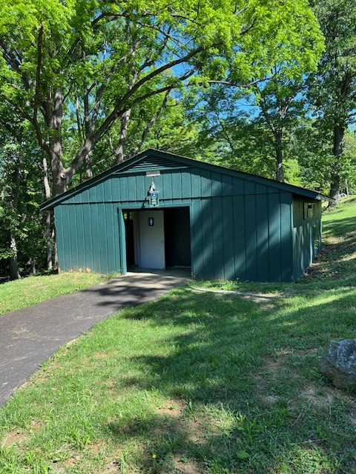
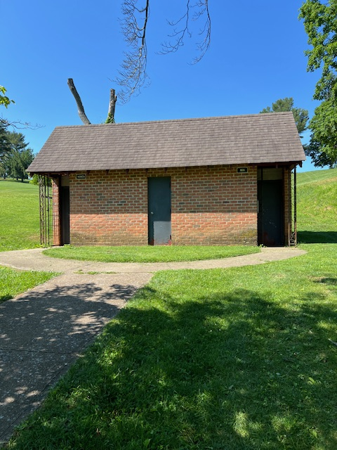
What’s Next In The Parks
Bathroom Renovations for Montgomery Hall Park and Gypsy Hill Park making services available year round

Slide 9
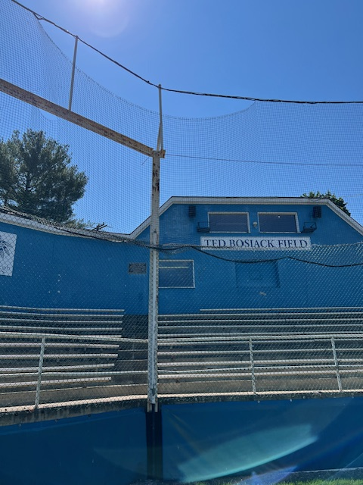
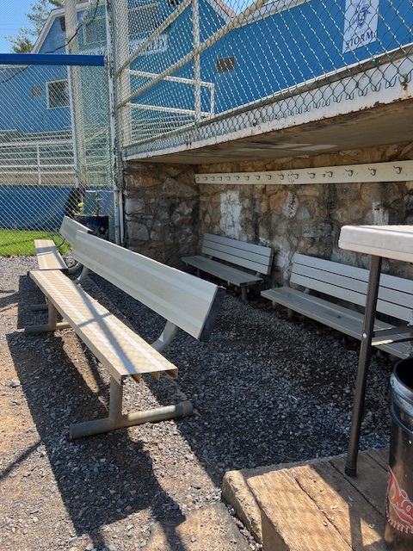
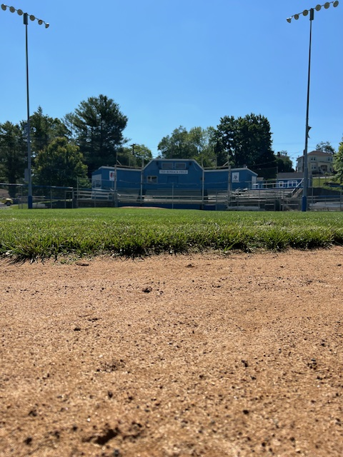
What’s Next In The Parks
Proposed Renovations for Moxie Baseball Stadium in Gypsy Hill Park. Improvements will focus on playability, ADA access, and player and fan experience.

Slide 10

The Resurgence of Gypsy Hill Golf Course

Slide 11
Powerful Changes In Effect
Improvements and Updates continue to happen at Gypsy Hill Golf Course. Following the execution of many key points in the course business plan, the following have skyrocketed:
Revenue
Rounds Played
Membership
Junior Programs
Women’s Clinics
Tournament Participation

Slide 12
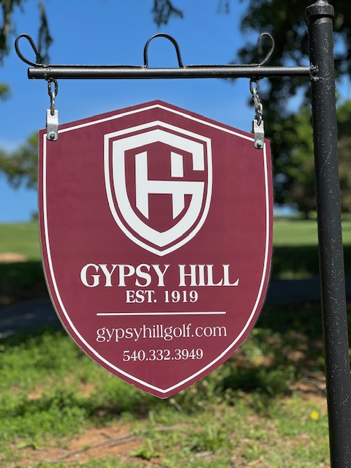
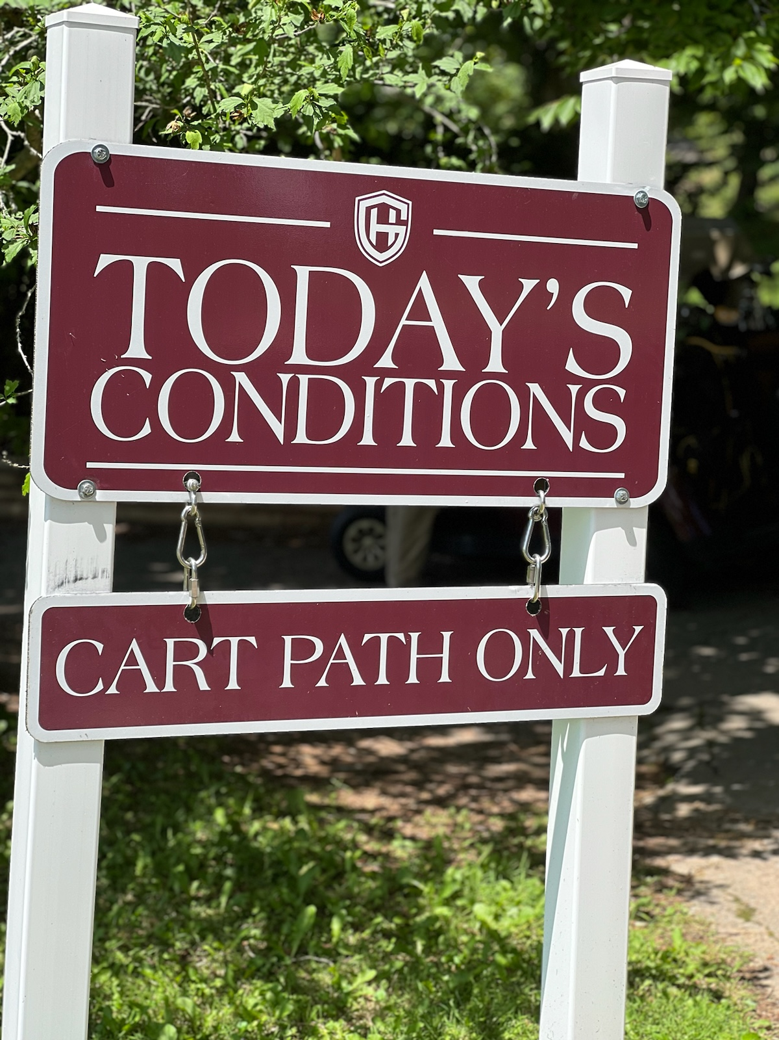
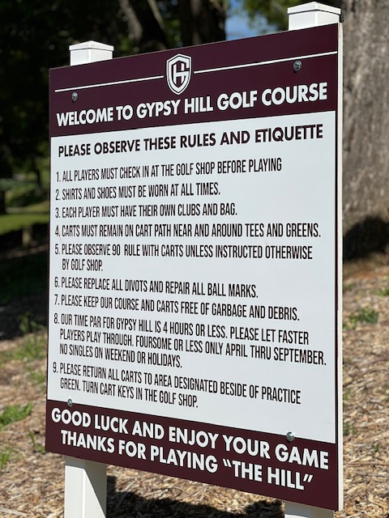
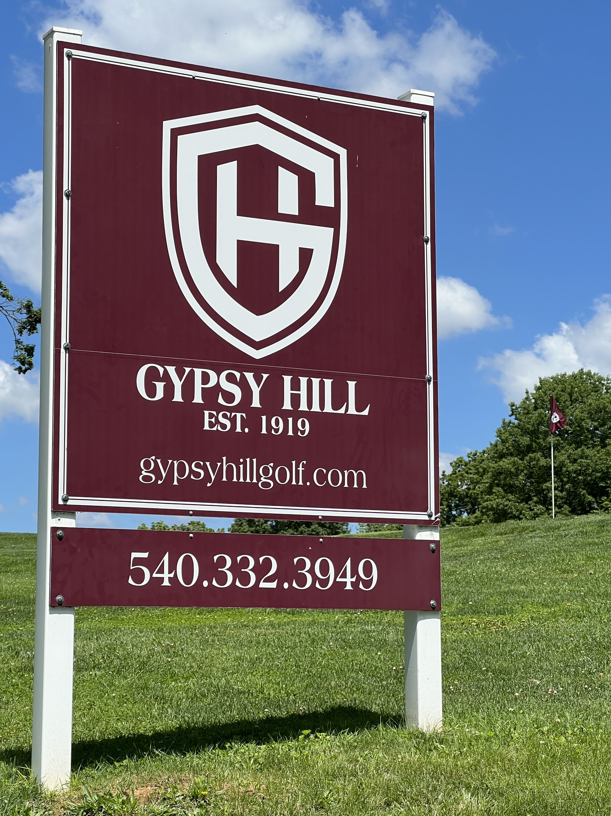
Navigating Q&A sessions
New Marketing and Logos, contributing to the facelift and updates the course and facility needed. All signage is professional and unified making the player experience seamless and informative.

Slide 13
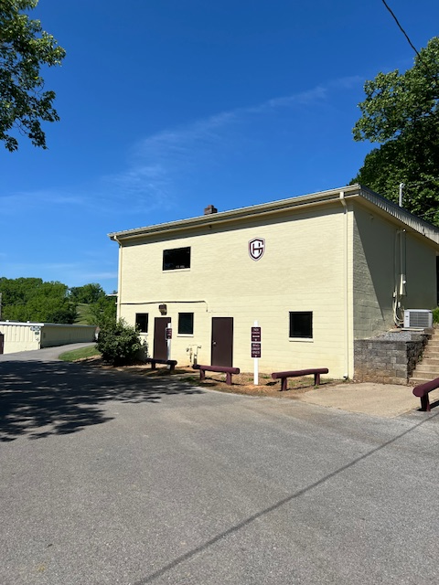
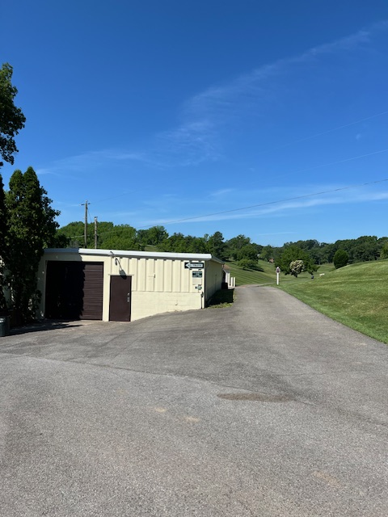
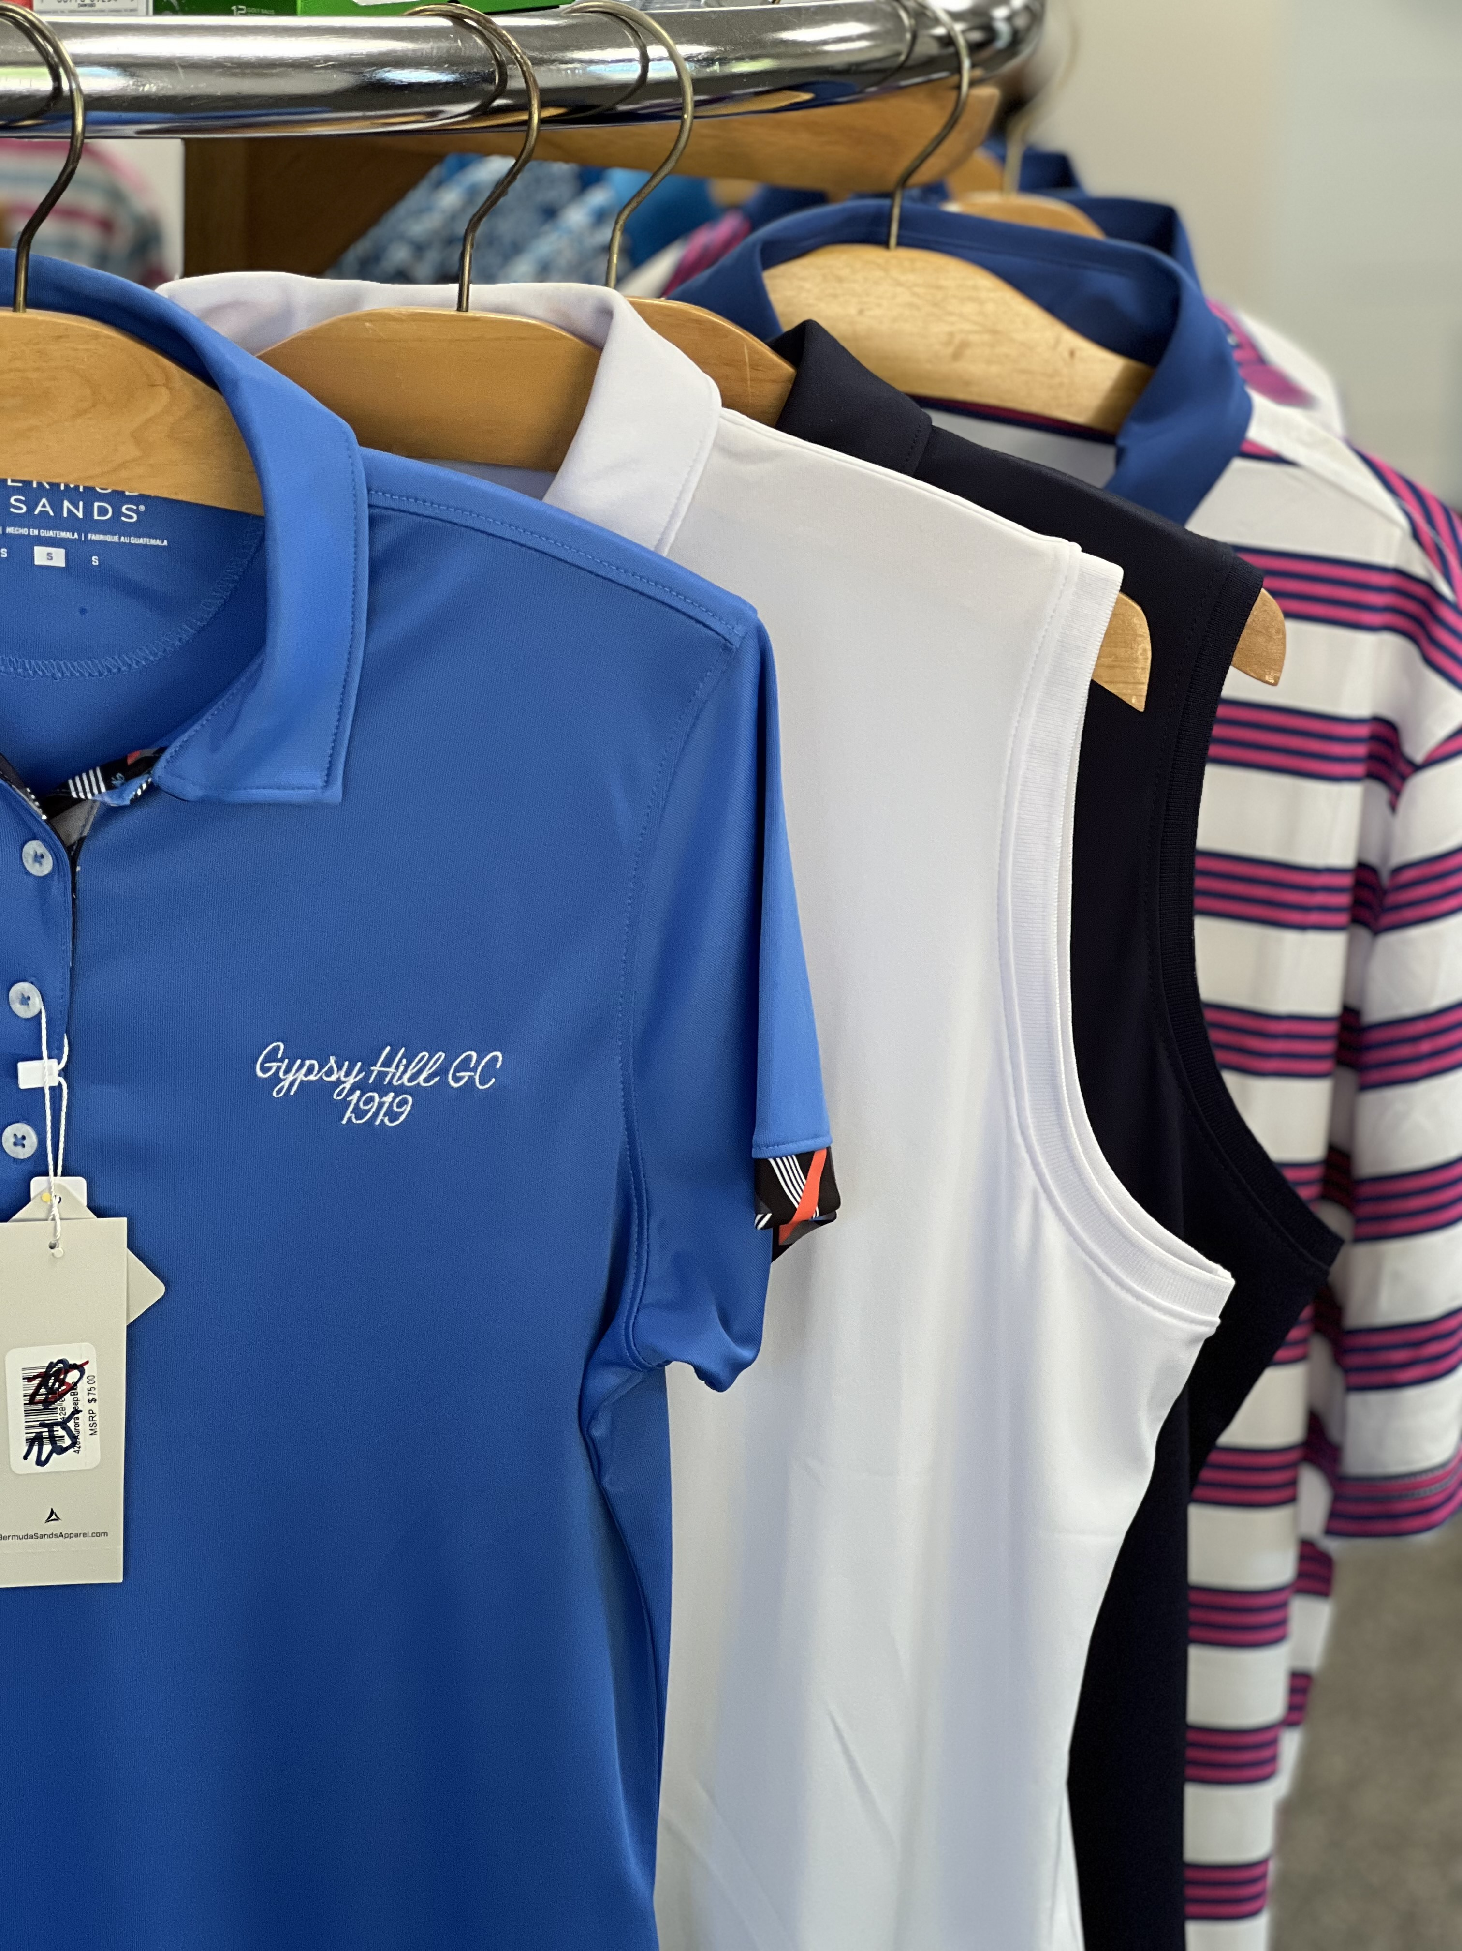
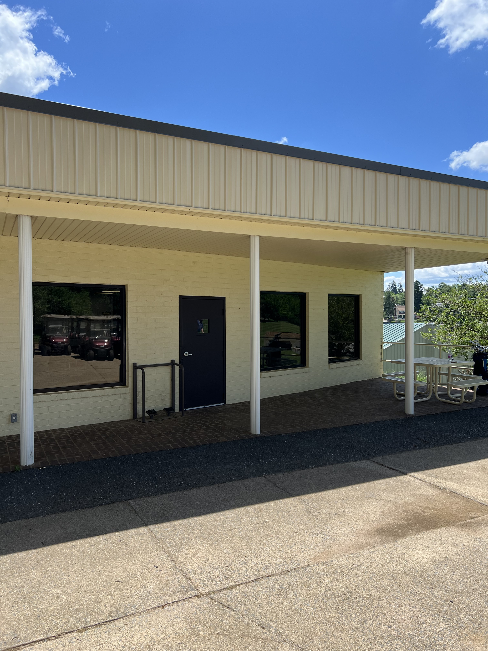
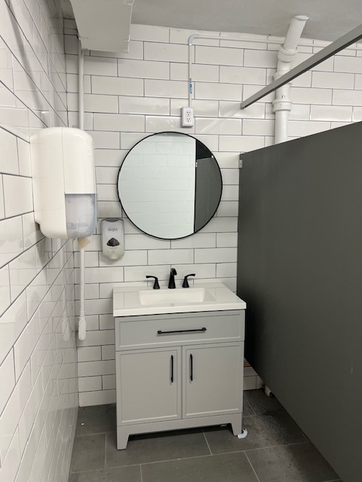
Navigating Q&A sessions
Pro Shop Updates
New Interior and Exterior Paint
New Carpet
New Counter
New Logo Merchandise
New Roof
Bathroom Updates
New Picnic Tables

Slide 14
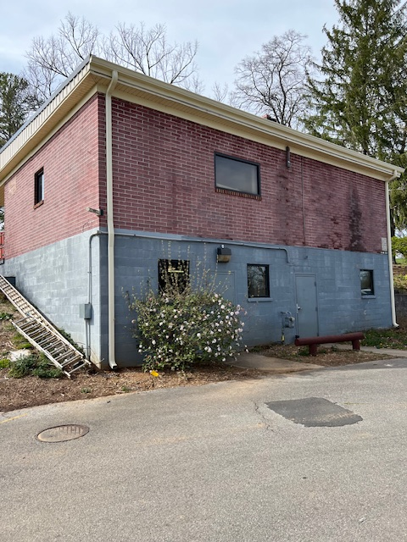
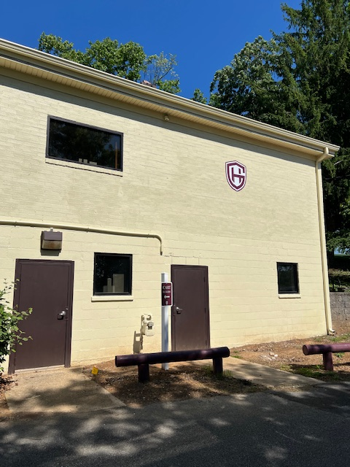
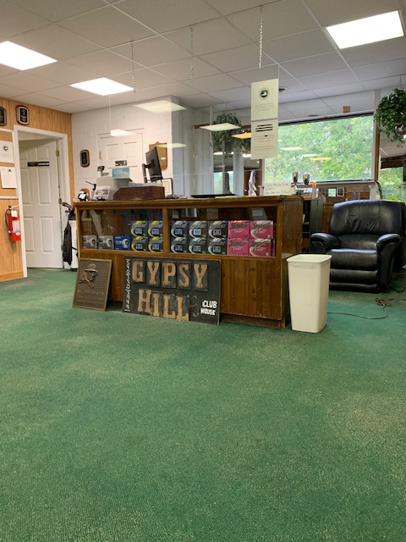
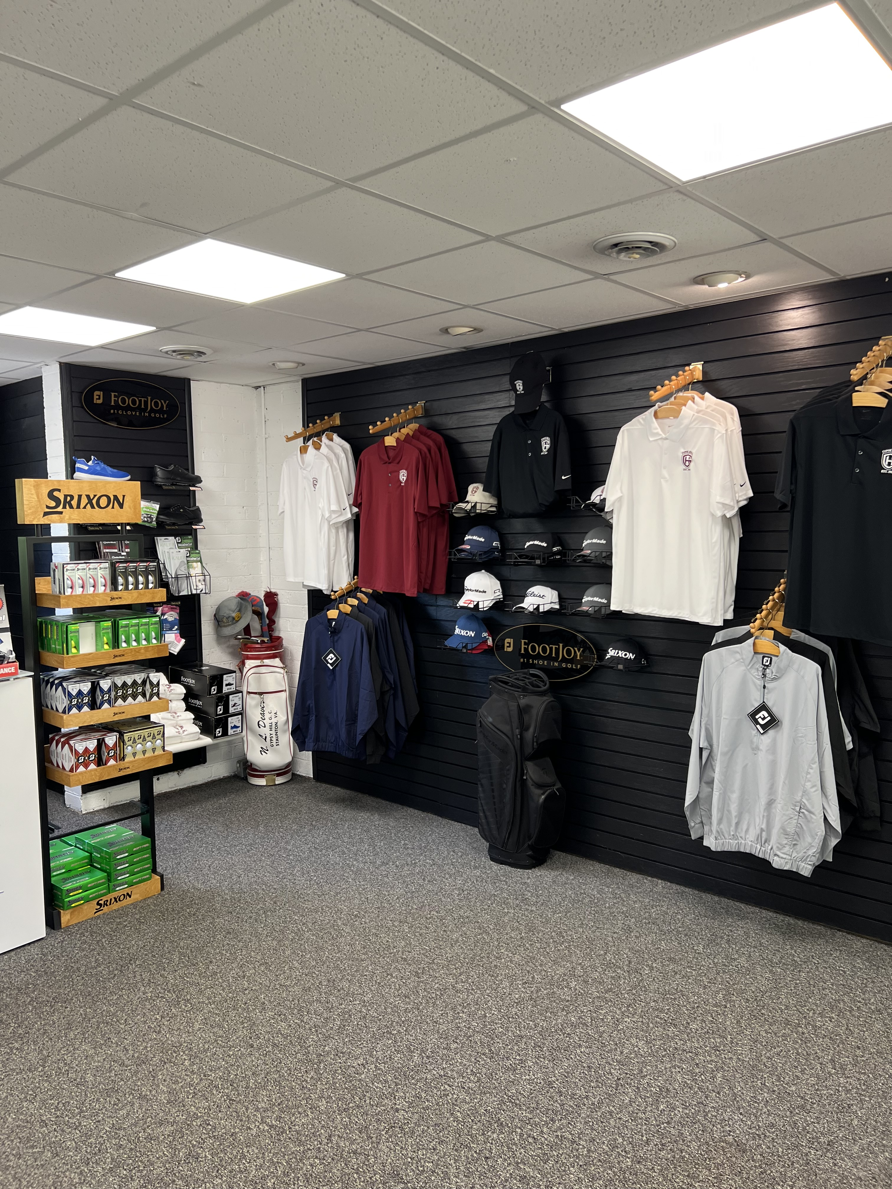
Navigating Q&A sessions
Before and After of Pro Shop

Slide 15
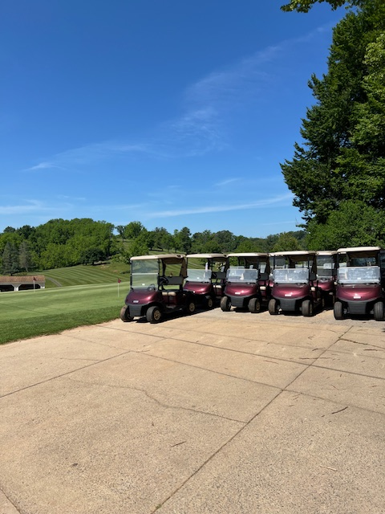
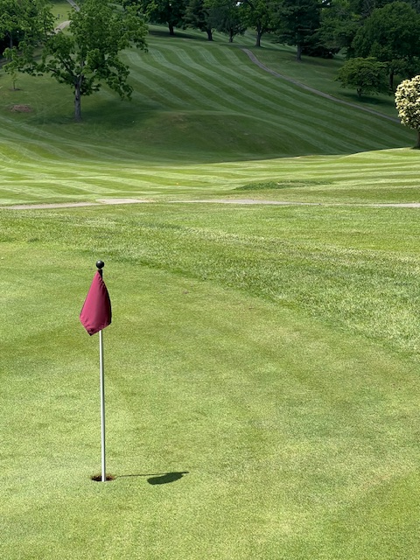
Impactful Golf Catalysts
Purchase of New Carts
New Point of Sale System
New Membership Pricing
New Programs
New Senior Tees
Improved Maintenance

Slide 16
Key Golf Takeaways
An In-depth Report on FY 2024 will be presented in October.
Revenues are averaging over $150,000 more per year than the previous 10 year average, after cart purchase. Over $500,000 in additional revenue since the implementation of the business plan.
  The Point of Sale System allows us to collect valuable data as we move forward.
  Public play continues to rise as the product upgrades
  Course conditions, accessibility, playability, and customer service keep progressing in a positive direction

Slide 17
Thank you
Chris Tuttle
tuttlecj@ci.Staunton.va.us
540-332-3945

