Slide 1
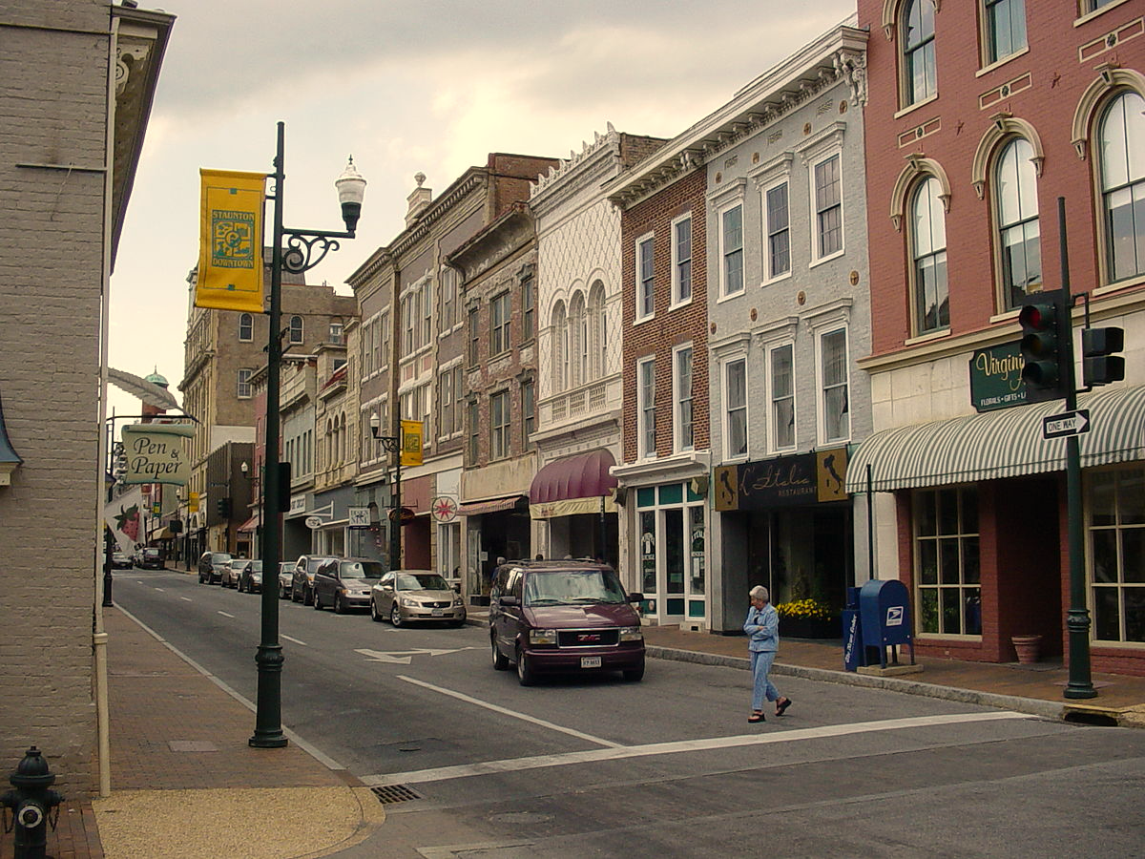
City of Staunton
2019/2020 substantial amendment
2021 annual action plan
Mullin & Lonergan Associates August 12,2021
This Photo by Unknown Author is licensed under CC BY-SA

Slide 2
2019 & 2020 Substantial Amendment
This Photo by Unknown Author is licensed under CC BY-SA

Slide 3




Substantial amendment process
According to federal regulation (24 CFR 91.505 (a) (1-3)), amendments must be made to the Consolidated Plan whenever CS makes one of the following decisions:
Carries out an activity, using funds from any program covered by the Consolidated Plan (including program income), not previously described in the action plan; or
Makes a substantial change in its allocation priorities or a substantial change in the method of distribution of funds;
Substantially changes the purpose, scope, location, or beneficiaries of an activity.

Slide 4
Proposed projects Amendments
2019 AAP Amendment | A Street Aging In Place Project
The City of Staunton proposing an amendment to current projects in the 2019 Entitlement CDBG allocation. The previously approved Habitat for Humanity Critical Home Repair Program will be cancelled, and the funds will be reallocated to the A Street Aging In Place Project. The project will meet the Con Plan goal Public Facilities and Infrastructure and the priority need of Improving Public Facilities and Infrastructure.
Funds will be used to provide 500 feet of water lines and 300 feet of water lines and road/curbs/gutter with turnaround This will provide water access for no less than 23 new units to be built at the end of A street for elderly/special needs housing. Street/curb/sidewalks for new housing units extended A Street. This is a multi-year project with total CDBG funding allocation of $271,149.
Reallocated CDBG funds for 2019: $25,000
2020 AAP Amendment | A Street Aging In Place Project
The City of Staunton proposing an amendment to the previously approved Habitat for Humanity project. This project will be cancelled, and the $25,000 funds will be reallocated to the A Street Aging In Place Project. The project will meet the Con Plan goal Public Facilities and Infrastructure and the priority need of Improving Public Facilities and Infrastructure.
Funds will be used to provide 500 feet of water lines and 300 feet of water lines and road/curbs/gutter with turnaround This will provide water access for no less than 23 new units to be built at the end of A street for elderly/special needs housing. Street/curb/sidewalks for new housing units extended A Street. This is a multi-year project with total CDBG funding allocation of $271,149 (FY 19 $25,000, FY 20 $92,313, FY 21 $ $153,836.00).
Reallocated CDBG funds for 2020: $25,000

Slide 5
Proposed projects Amendments
2020 AAP Amendment | Rockway Street Waterline Project
The City of Staunton proposing an amendment to current projects in the 2020 Entitlement CDBG allocation. Funds in 2019 to accommodate the increased funding for the Valley Supportive Housing Roof project, the City reduced funds for the Rockway Street Waterline so that the more immediate need to fully fund the Valley Supportive Housing project could be completed. The Rockway Street Waterline project is a multi-year project that will be completed in a future funding year. To accommodate the reduction, the City proposes funding the project in FY2020 to make up the funding difference. The total allocation for the multiyear project is $160,796 (FY19 $125,796; FY20 $35,000).
The additional funding allocation for the Rockway Street Waterline project for the FY2020 AAP is $25,000.

Slide 6
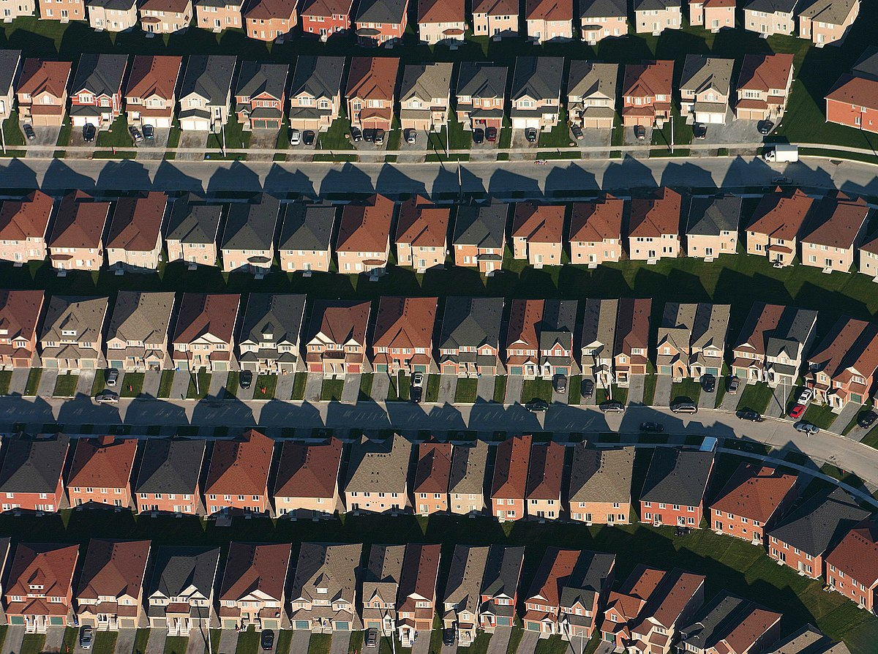
2021 Annual Action Plan
This Photo by Unknown Author is licensed under CC BY-SA

Slide 7





CP & AAP Process
Stakeholder Consultation
Housing Market Analysis
Local government, public and private agencies, housing authority, etc.
Utilize quantifiable data, stakeholder input, and citizen participation to develop this section
Housing and Homeless Needs Assessment
Strategic Plan
Priorities for 2019 thru 2023
  Utilize quantifiable data, stakeholder input, and citizen participation to develop this section
Annual Action Plan
  Proposed activities for 2021
Notes:
The 2021 Annual Action Plan covers the period of October 1, 2021 thru September 30, 2022

Slide 8
Basic CDBG eligible activities
Housing Rehabilitation
Homeownership Assistance
Public Facilities and Improvements
Blight Removal Demolition/Site Preparation
Code Enforcement
Economic Development
Acquisition / Disposition of Real Property
Public Services

Slide 9
Meeting National Objectives
Each activity must meet one of the
THREE NATIONAL OBJECTIVES:
Benefit Low- and Moderate-Income Persons
(at least 70% of grant amount)
Prevent or Eliminate Blight
(not more than 30% of grant amount)
Meet Urgent Needs when health and welfare are threatened

Slide 10
CONSOLIDATED PLAN GOALS
Improve Access to and Quality of Housing
Provide Public Services
Improve Public Facilities and Infrastructure
Economic Development
Planning and Administration

Slide 11
Definition of low- and moderate income
Household Size | Maximum Income (80%) HAMFI for Staunton-Waynesboro, VA MSA
1 person | $39,900
2 person | $45,600
3 person | $51,300
4 person | $56,950
5 person | $61,550
6 person | $66,100
7 person | $70,650
8 person | $75,200
City of Staunton 2021

Slide 12

Available Funds for 2021
CDBG: $344,362

Slide 13
Proposed projects 2021
Public Services
Valley Mission, Inc Initial Housing Support Program | $5,000 : Formally homeless individuals who move into housing within Staunton City limits after exiting Valley Mission will be assisted with approximately $500 to $1,000 each initial housing support or other funds necessary to facilitate moving into safe, affordable, permanent, and appropriate housing for 5 persons.
VPAS Senior Transportation Program (STP) | $10,000 : VPAS’ Senior Transportation Program (STP) provides 30 elderly Staunton residents and those under 60 with a disability transportation services to medical and other life necessary destinations when there is no other reliable or affordable transportation option available to them.
VPAS Meals on Wheels | $10,000 : Meals on Wheels (MOW) program provides a nutritious hot meal five days per week to 95 frail, older Staunton residents who are at nutritional risk.
Blue Ridge Legal Services | $11,654 : BRLS will provide free legal assistance to 12 low-income Staunton residents facing civil legal issues as a result of the pandemic and subsequent economic crisis.
Blue Ridge CASA | $11,500 : Blue Ridge CASA will provide advocacy for abused and neglected children. The proposed activities will directly benefit at least 60 low-income children living in unstable and inadequate housing conditions who have been victims of abuse or neglect and have special needs.

Slide 14
Proposed projects 2021
Improve Public Infrastructure
A Street Aging in Place Project | $153,836 : Funding will be used to develop streets, gutters, sidewalks and water lines for no less than 23 new homes at the end of A Street in Staunton, Virginia.
Public Facility Improvements‐West Beverly Street Sidewalk | $40,000 : Project involves replacing 500 linear feet of sidewalk along W. Beverley Street from Grubert to Dollar General to improve ADA accessibility. Approximately 518 low-income households will benefit from proposed project.
Re-Roofing Staunton | $30,000 : The scope of this project would include roof replacement for approximately 3 low‐income homeowners (primarily seniors).
Administration
CDBG Program Administration | $68,872 : This funding is used to support the general administration and planning activities for the Community Development Block Grant Program including subgrantee monitoring and technical assistance, annual reporting, financial support, annual grant applications, etc..

Slide 15
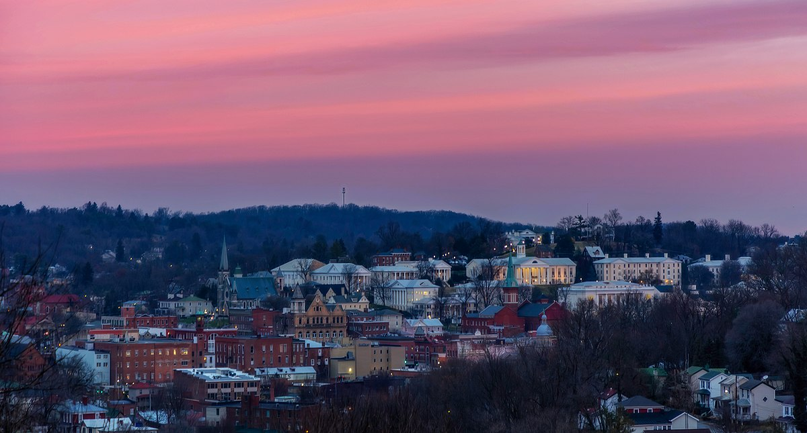
Schedule for submission to Hud
2021 Annual Action Plan, 2019 Substantial Amendment and 2020 Substantial Amendment on display on or about June 28, 2021 for 30 days.
City Council review and anticipated adoption August 12, 2021
Submission to HUD on or before August 15, 2021.
Program start October 1, 2021.

